Slide 1
The Cascadia subduction zone introduced a whole new ballgame for Earthquake Hazards here in the Pacific Northwest – making our WORLD now more SERIOUS!

Slide 2
SASQUAKES are here in the Pacific Northwest
GIGANTICUS SUBDUCTUS, and they will leave their BIG FOOTPRINT AGAIN!
Are we going to design for the M9 Earthquake with its 5 minutes of shaking or not?

Slide 3
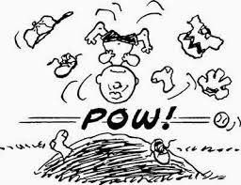
There is nothing more difficult to carry out, nor more doubtful of success, nor more dangerous to handle than to initiate a new order of things

Slide 4
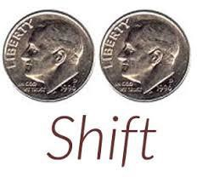
Yogi Berra told us: “A Nickel Ain’t Worth a Dime Anymore.”
If I have 2 dimes and they are now worth $ 0.25 . . . that’s a Pair-A-Dime SHIFT.

Slide 5
When we forget . . . a new narrative can come in that isn’t true. Such is the present
case of PSHA, USGS’s creation (1976) and un-let-go-able paradigm for now more than
50 yrs – the same age as the Internet, the same age as plate tectonics!

Slide 6
Why a New Paradigm for Seismic Hazard Assessment?
Because the separation of science and engineering is a human imposition – they are both part of one indivisible phenomenon. And because for 3 decades PSHA has de- livered ambiguous, unreliable, and globally too deadly results: > 700,000 casualties in regions where seismic hazard was mapped to be low, but Nature and the regional tectonics unfortunately acted otherwise!

Slide 7
PSHA is pretty much a numerical creation, wherein probability is pulled out of a model , there is no annual frequency of earthquakes ( you may have noticed?), nor such a thing as earthquake return period. BUMMER!

Slide 8
Unreliability started with “The Charleston Issue.” 1982 USGS announced to US NRC “ that an 1886 Charleston-size earthquake 7.5 could occur anywhere along the eastern seaboard in geologic / tectonic settings similar to that near Charles- ton, South Carolina – placing forbidding demands on design and construction of critical facilities from Maine to Mar-A-Lago – Voila!
“The Charleston Issue” was treated probabilistically.

Slide 9
NDSHA: A New Paradigm for Reliable Seismic Hazard Assessment
explains why Nature and nature’s geometry have no contracts to agree with mathematics.

Slide 10
The scenario-based NDSHA modeling technique is developed from comprehensive geophysical knowledge of : (i) seismic source process ; (ii) propagation of earthquake waves ; (iii) combined interactions with site conditions.
Thus NDSHA effectively accounts for the tensor nature of earthquake ground motions.

Slide 11
The procedure for the NDSHA derived Seismic Hazard Maps at the regional scale is described in some detail at:
http://www.xeris.it/Hazard/index.html
Development of seismic hazard maps at the regional scale, based on the computation of complete synthetic seismograms and taking into account the seismic history, seismogenic potential and average structural properties of the medium in the region.

